Slide 1
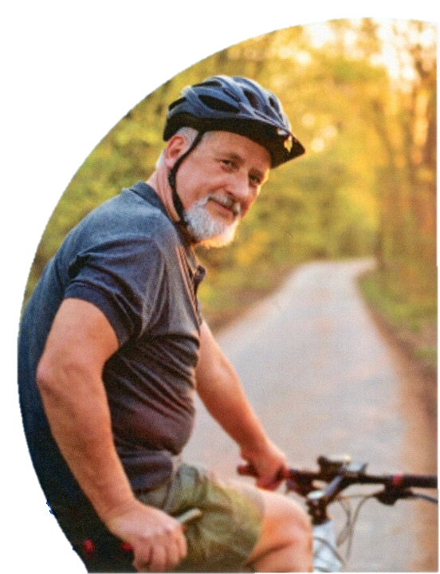
How can
A Prostate Cancer
Support Group Help
Peter Gebert
Convenor
Eltham Prostate Cancer Information and Support Group
www.epcisg.org
Notes:
15

Slide 2
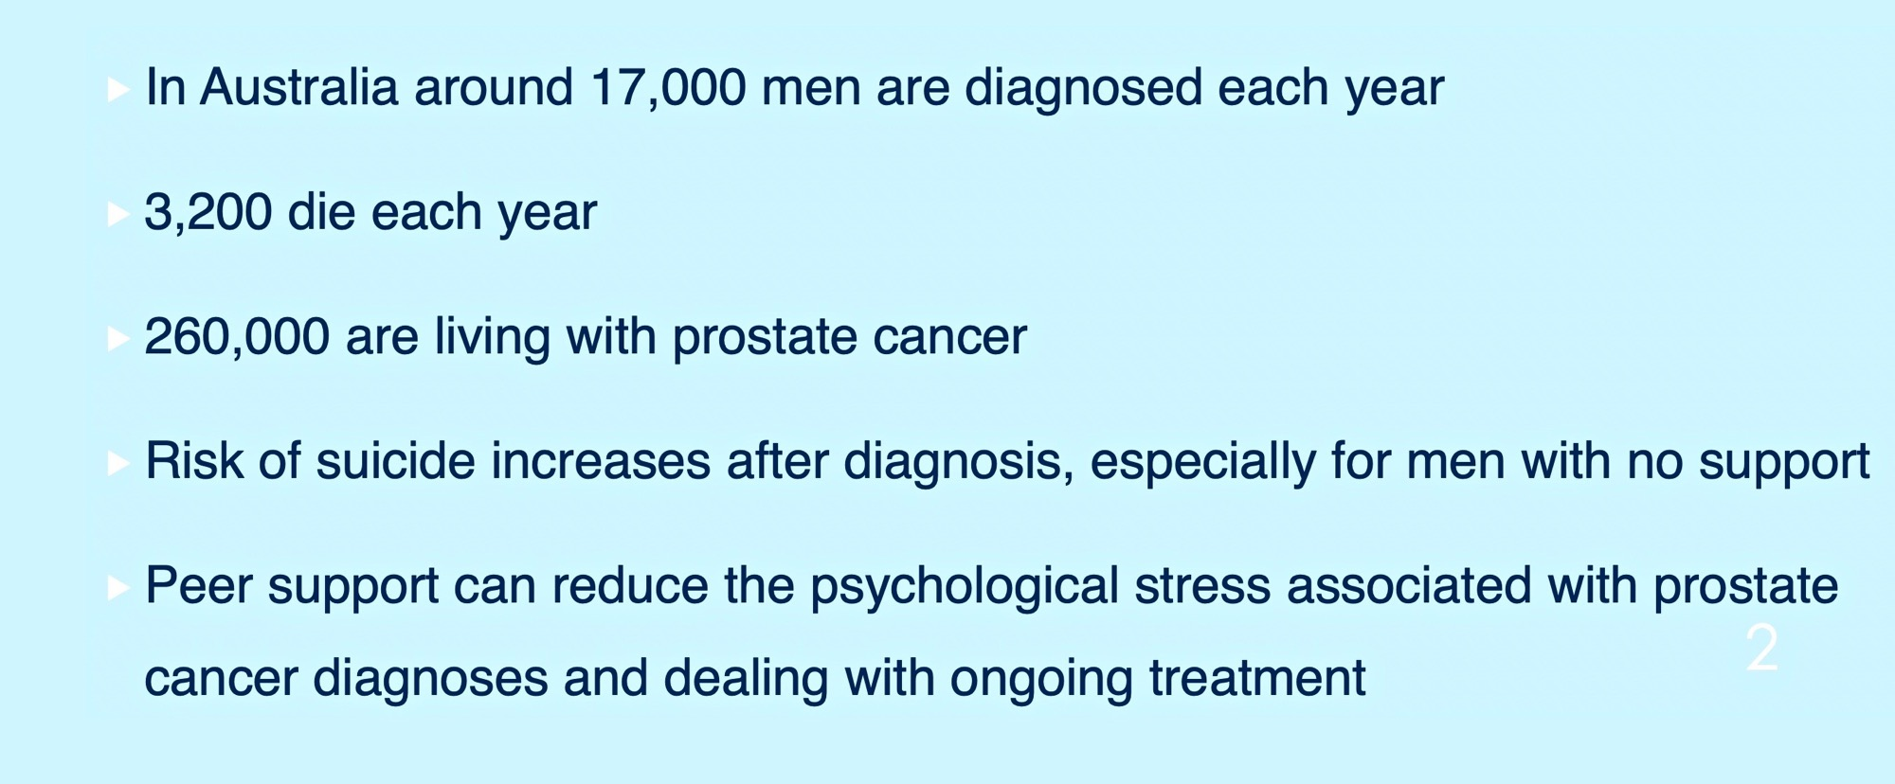
A Reminder About Prostate Cancer
2
Notes:
A reminder about prostate cancer:
In Australia around 20,000 men are diagnosed each year.
3,300 die each year.
260,000 are living with prostate cancer.
Suicide increases after diagnosis, especially for men with no support.
Peer support can reduce the psychological stress associated with prostate cancer diagnoses and dealing with on-going treatment.
3 Questions:
ME: a little exercise for these questions, make yourself comf:,close your eyes if you feel ok doing that. HANDS UP IF:
Who has heard of prostate cancer support groups? LEAVE UP IF:
Would you refer men to a group?
Do you think it is important that men are informed of the groups?
When you are ready open your eyes.
ME-How many put hands up, Numbers for each one??
Did it feel easier to do with eyes closed, so others didn’t see your responses?
<number>

Slide 3
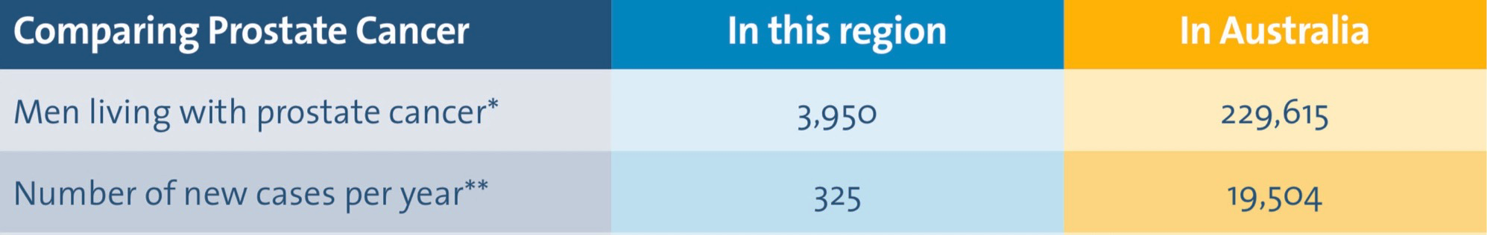
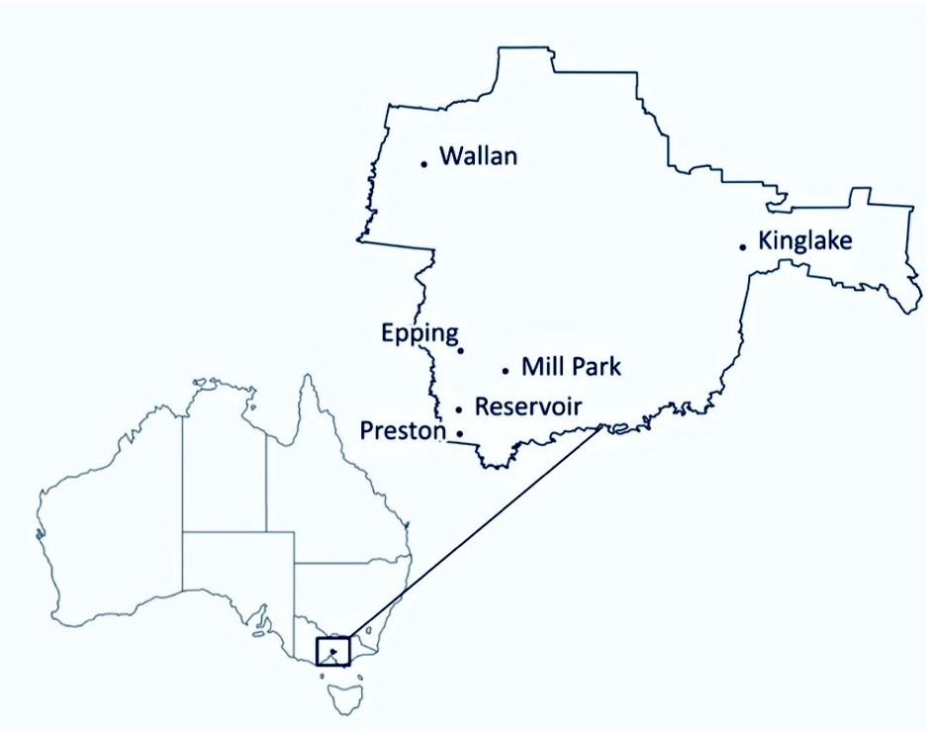

<number>
Notes:
A reminder about prostate cancer:
In Australia around 20,000 men are diagnosed each year.
3,300 die each year.
260,000 are living with prostate cancer.
Suicide increases after diagnosis, especially for men with no support.
Peer support can reduce the psychological stress associated with prostate cancer diagnoses and dealing with on-going treatment.
3 Questions:
ME: a little exercise for these questions, make yourself comf:,close your eyes if you feel ok doing that. HANDS UP IF:
Who has heard of prostate cancer support groups? LEAVE UP IF:
Would you refer men to a group?
Do you think it is important that men are informed of the groups?
When you are ready open your eyes.
ME-How many put hands up, Numbers for each one??
Did it feel easier to do with eyes closed, so others didn’t see your responses?
<number>

Slide 4
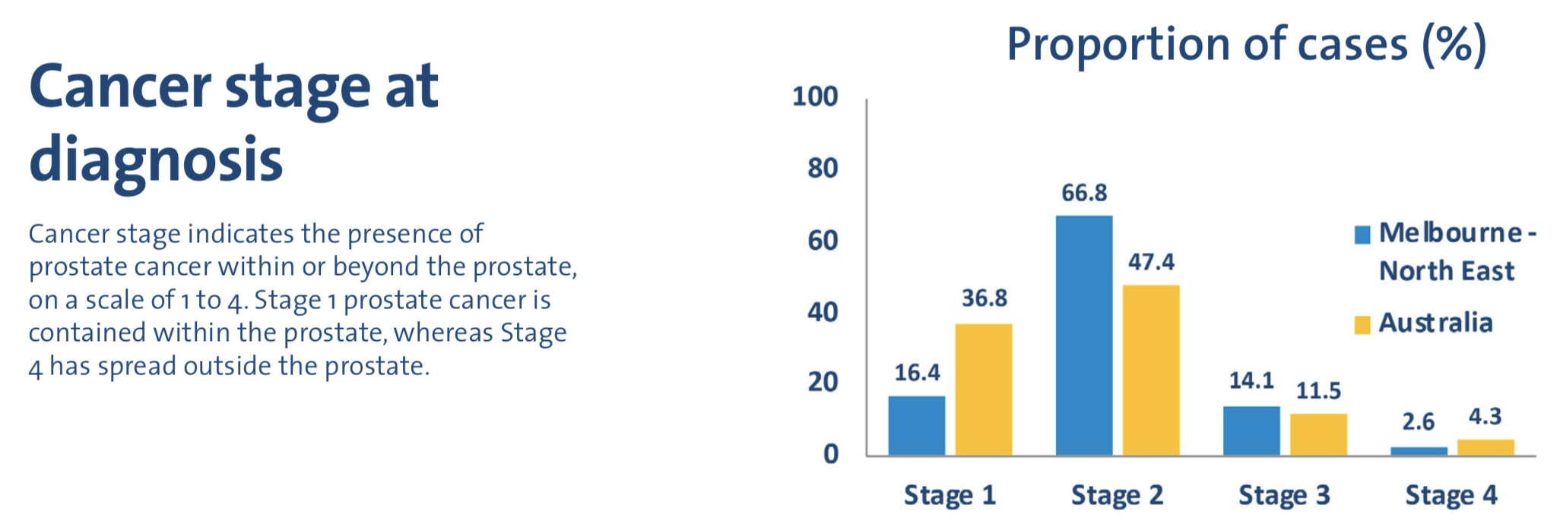

<number>
Notes:
A reminder about prostate cancer:
In Australia around 20,000 men are diagnosed each year.
3,300 die each year.
260,000 are living with prostate cancer.
Suicide increases after diagnosis, especially for men with no support.
Peer support can reduce the psychological stress associated with prostate cancer diagnoses and dealing with on-going treatment.
3 Questions:
ME: a little exercise for these questions, make yourself comf:,close your eyes if you feel ok doing that. HANDS UP IF:
Who has heard of prostate cancer support groups? LEAVE UP IF:
Would you refer men to a group?
Do you think it is important that men are informed of the groups?
When you are ready open your eyes.
ME-How many put hands up, Numbers for each one??
Did it feel easier to do with eyes closed, so others didn’t see your responses?
<number>

Slide 5
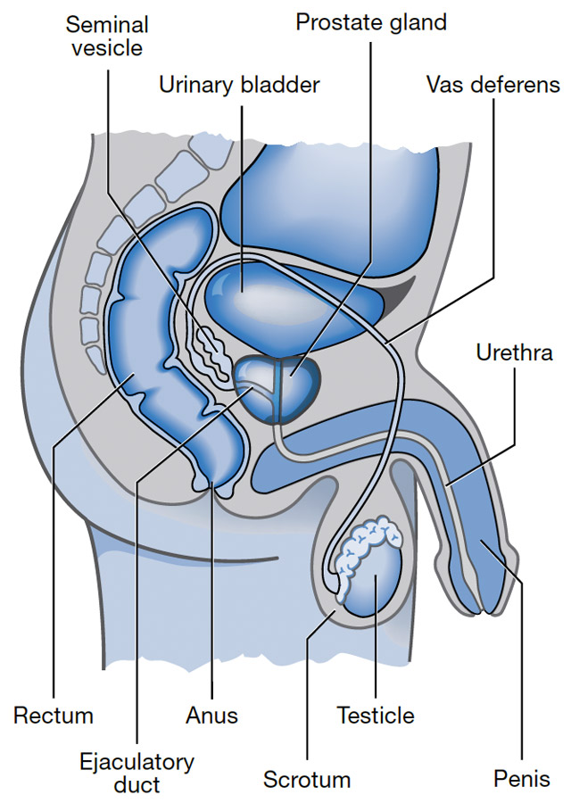
WHAT IS A PROSTATE
5
Notes:
A reminder about prostate cancer:
In Australia around 20,000 men are diagnosed each year.
3,300 die each year.
260,000 are living with prostate cancer.
Suicide increases after diagnosis, especially for men with no support.
Peer support can reduce the psychological stress associated with prostate cancer diagnoses and dealing with on-going treatment.
3 Questions:
ME: a little exercise for these questions, make yourself comf:,close your eyes if you feel ok doing that. HANDS UP IF:
Who has heard of prostate cancer support groups? LEAVE UP IF:
Would you refer men to a group?
Do you think it is important that men are informed of the groups?
When you are ready open your eyes.
ME-How many put hands up, Numbers for each one??
Did it feel easier to do with eyes closed, so others didn’t see your responses?
<number>

Slide 6
What are the early symptoms
of Prostate Cancer
<number>
Notes:
A reminder about prostate cancer:
In Australia around 20,000 men are diagnosed each year.
3,300 die each year.
260,000 are living with prostate cancer.
Suicide increases after diagnosis, especially for men with no support.
Peer support can reduce the psychological stress associated with prostate cancer diagnoses and dealing with on-going treatment.
3 Questions:
ME: a little exercise for these questions, make yourself comf:,close your eyes if you feel ok doing that. HANDS UP IF:
Who has heard of prostate cancer support groups? LEAVE UP IF:
Would you refer men to a group?
Do you think it is important that men are informed of the groups?
When you are ready open your eyes.
ME-How many put hands up, Numbers for each one??
Did it feel easier to do with eyes closed, so others didn’t see your responses?
<number>

Slide 7
SUPPORT GROUPS IN AUSTRALIA
Over 150 Support groups in Australia
In Victoria we have over 30 groups
The nearest Groups are in Eltham and Heidelberg
Meet once a month some at night others during the day
7
Notes:
QUOTES FROM SUPPORT GROUPS:
“The monthly-regular meetings are an opportunity to help others overcome stressful events. This is the stand out point of the success of the group”
ME: Note-Stressful, the diagnosis of cancer and all that it entails, deeply impacts on men, and their partners. Especially waiting on the pathology report.
I call it “Wounding of the Soul”, that is a separate presentation.
“Friendship, support and assistance with navigating the sea of information, and resources available were the groups goals”.
“Friendly ear in time of need:
“Talk to others, individuals who have had similar treatments-outcomes, compare-discuss them”
ME: A lot of groups keep abreast of cancer research and treatments, have newsletters sent out with links to research. Send emails with info and the groups activities.
Some get involved with fund raising and awareness of prostate cancer via info stands at different events. Organise info evenings about P/C with presenters.
AND PLUG FOR THE NAVIGATE TRIAL BEING RUN OUT OF PETER MAC, FOR LOW RISK PROSTATE CANCER. FLYERS ARE HERE FOR YOUR INFO.
A common theme from groups: Men are not alone, there is support, <anxiety, sharing the burden. Like other support groups, with chronic health issues, a shared burden.
<number>

Slide 8
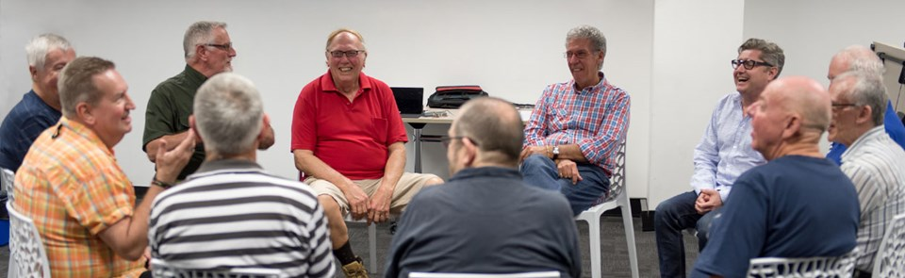
WHY A SUPPORT GROUP
Reduce the feeling of loneliness in dealing with prostate cancer
Gain relief from feelings of fear and depression
Men don’t feel isolated - they feel supported
Get tips and hear what others have done
Meet others who have been there
Receive and provide support
<number>
Notes:
A reminder about prostate cancer:
In Australia around 20,000 men are diagnosed each year.
3,300 die each year.
260,000 are living with prostate cancer.
Suicide increases after diagnosis, especially for men with no support.
Peer support can reduce the psychological stress associated with prostate cancer diagnoses and dealing with on-going treatment.
3 Questions:
ME: a little exercise for these questions, make yourself comf:,close your eyes if you feel ok doing that. HANDS UP IF:
Who has heard of prostate cancer support groups? LEAVE UP IF:
Would you refer men to a group?
Do you think it is important that men are informed of the groups?
When you are ready open your eyes.
ME-How many put hands up, Numbers for each one??
Did it feel easier to do with eyes closed, so others didn’t see your responses?
<number>

Slide 9
WHO SHOULD ATTEND
A SUPPORT GROUP
Anyone wanting information about Prostate Cancer
Anyone newly Diagnosed
Anyone with side effects from treatments
Anyone living with Prostate Cancer who want to help others
Anyone who wants to help the Group support the Community
9
Notes:
QUOTES:
▪ To give and receive support
▪ To know that you are not alone
▪ To be able to speak freely about your concerns, as Adrian did
▪ Great speakers who can give up to date info, etc.
▪ No matter how you think you are going there is always someone else who is doing it tougher!
▪ The 'gallows humour"-black humour helps lighten things without taking away from the serious side of the meetings.
ME:
As you can see there is a recurrent theme coming through about support.
Support groups exist to support men and their partners through their journey.
Men get to hear about options and side effects that in some case are not told about.
SG’s are not there to tell men not to have a particular t/ment.
Men often say -A great sense of relief in talking to others in an informal setting-there is no judgement. Feel more confident after the meeting.
<number>

Slide 10

PARTNERS AND FAMILY ARE WELCOME
Partners are affected by the diagnosis
Often Partners or Children do the research
Impacts relationships, emotionally, physically and mentally
Partners find relief in speaking with others as well
Some can feel left out of the decision making
Most groups have women attending
Group support for the whole family
10
Notes:
QUOTES:
▪ To give and receive support
▪ To know that you are not alone
▪ To be able to speak freely about your concerns, as Adrian did
▪ Great speakers who can give up to date info, etc.
▪ No matter how you think you are going there is always someone else who is doing it tougher!
▪ The 'gallows humour"-black humour helps lighten things without taking away from the serious side of the meetings.
ME:
As you can see there is a recurrent theme coming through about support.
Support groups exist to support men and their partners through their journey.
Men get to hear about options and side effects that in some case are not told about.
SG’s are not there to tell men not to have a particular t/ment.
Men often say -A great sense of relief in talking to others in an informal setting-there is no judgement. Feel more confident after the meeting.
<number>

Slide 11
Quotes from Support Groups
“The regular meetings are an opportunity to help others overcome stressful events. This is the stand-out point of the success of the group.”
“Friendship, support and assistance with navigating the sea of information and resources available were the group’s goals.”
“Friendly ear in time of need.”
“Talk to others who have had similar treatments / outcomes, compare / discuss them.”
11
Notes:
QUOTES FROM SUPPORT GROUPS:
“The monthly-regular meetings are an opportunity to help others overcome stressful events. This is the stand out point of the success of the group”
ME: Note-Stressful, the diagnosis of cancer and all that it entails, deeply impacts on men, and their partners. Especially waiting on the pathology report.
I call it “Wounding of the Soul”, that is a separate presentation.
“Friendship, support and assistance with navigating the sea of information, and resources available were the groups goals”.
“Friendly ear in time of need:
“Talk to others, individuals who have had similar treatments-outcomes, compare-discuss them”
ME: A lot of groups keep abreast of cancer research and treatments, have newsletters sent out with links to research. Send emails with info and the groups activities.
Some get involved with fund raising and awareness of prostate cancer via info stands at different events. Organise info evenings about P/C with presenters.
AND PLUG FOR THE NAVIGATE TRIAL BEING RUN OUT OF PETER MAC, FOR LOW RISK PROSTATE CANCER. FLYERS ARE HERE FOR YOUR INFO.
A common theme from groups: Men are not alone, there is support, <anxiety, sharing the burden. Like other support groups, with chronic health issues, a shared burden.
<number>

Slide 12
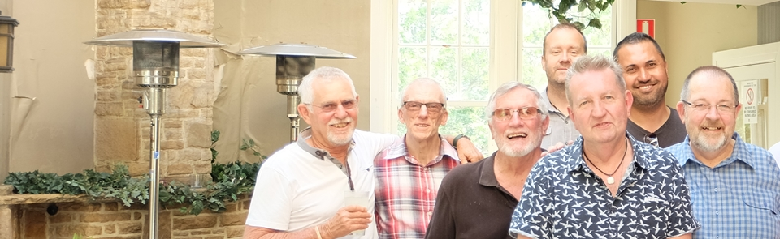
Shared experiences
No agenda and everyone’s equal
Brings men together for a common cause
Common interest in raising awareness of prostate cancer with public talks
12
Notes:
QUOTES:
▪ To give and receive support
▪ To know that you are not alone
▪ To be able to speak freely about your concerns, as Adrian did
▪ Great speakers who can give up to date info, etc.
▪ No matter how you think you are going there is always someone else who is doing it tougher!
▪ The 'gallows humour"-black humour helps lighten things without taking away from the serious side of the meetings.
ME:
As you can see there is a recurrent theme coming through about support.
Support groups exist to support men and their partners through their journey.
Men get to hear about options and side effects that in some case are not told about.
SG’s are not there to tell men not to have a particular t/ment.
Men often say -A great sense of relief in talking to others in an informal setting-there is no judgement. Feel more confident after the meeting.
<number>

Slide 13
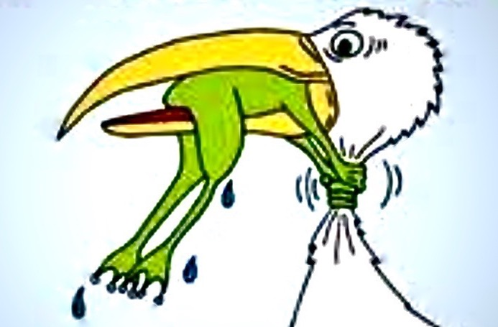
THIS FROG IS A REAL
PROSTATE WARRIOR AND YOUR TYPICAL MAN
AT A SUPPORT GROUP
Notes:
<number>

Slide 14

Eltham Prostate Cancer Information and Support Group
Has existed for 17 Years, is confidential and free to attend
Meets monthly at the CFA in Eltham on third Monday at 7pm
Has helped over 200 men in our community over the years
Doesn’t require you to attend after your initial visit
Doesn’t provide medical advice
Has professional speakers
Has a Prostate Cancer Nurse associated with it
14
Notes:
QUOTES:
▪ To give and receive support
▪ To know that you are not alone
▪ To be able to speak freely about your concerns, as Adrian did
▪ Great speakers who can give up to date info, etc.
▪ No matter how you think you are going there is always someone else who is doing it tougher!
▪ The 'gallows humour"-black humour helps lighten things without taking away from the serious side of the meetings.
ME:
As you can see there is a recurrent theme coming through about support.
Support groups exist to support men and their partners through their journey.
Men get to hear about options and side effects that in some case are not told about.
SG’s are not there to tell men not to have a particular t/ment.
Men often say -A great sense of relief in talking to others in an informal setting-there is no judgement. Feel more confident after the meeting.
<number>

Slide 15
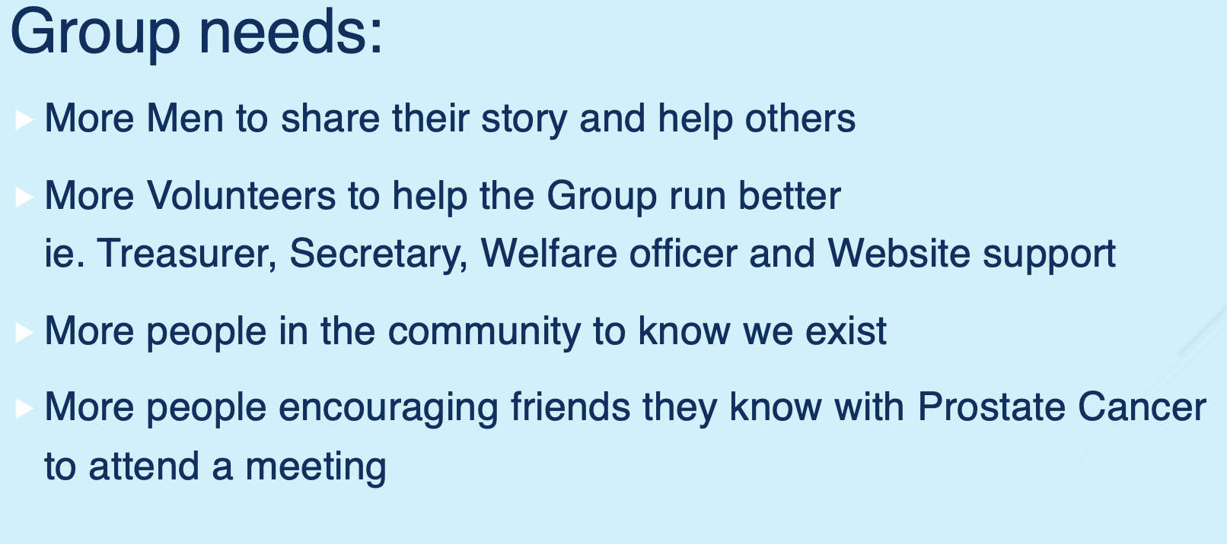
CALL TO ACTION
<number>
Notes:
QUOTES:
▪ To give and receive support
▪ To know that you are not alone
▪ To be able to speak freely about your concerns, as Adrian did
▪ Great speakers who can give up to date info, etc.
▪ No matter how you think you are going there is always someone else who is doing it tougher!
▪ The 'gallows humour"-black humour helps lighten things without taking away from the serious side of the meetings.
ME:
As you can see there is a recurrent theme coming through about support.
Support groups exist to support men and their partners through their journey.
Men get to hear about options and side effects that in some case are not told about.
SG’s are not there to tell men not to have a particular t/ment.
Men often say -A great sense of relief in talking to others in an informal setting-there is no judgement. Feel more confident after the meeting.
<number>

Slide 16

We meet:
7pm - Third Monday of every month
Eltham Country Fire Authority Building or via Zoom
Contact us: 0468 315 156 info@epcisg.org
All men, their partners and family members are warmly welcomed
Notes:
QUOTES:
▪ To give and receive support
▪ To know that you are not alone
▪ To be able to speak freely about your concerns, as Adrian did
▪ Great speakers who can give up to date info, etc.
▪ No matter how you think you are going there is always someone else who is doing it tougher!
▪ The 'gallows humour"-black humour helps lighten things without taking away from the serious side of the meetings.
ME:
As you can see there is a recurrent theme coming through about support.
Support groups exist to support men and their partners through their journey.
Men get to hear about options and side effects that in some case are not told about.
SG’s are not there to tell men not to have a particular t/ment.
Men often say -A great sense of relief in talking to others in an informal setting-there is no judgement. Feel more confident after the meeting.
<number>

